Slide 1
The World of the
Qubit
Understanding the fundamental building block of
quantum computing

Slide 2
Bits vs. Qubits
Classical Bit: Binary state (0 or 1),
deterministic, and the foundation of
traditional computing.
Qubit: Quantum state (superposition),
probabilistic, and the fundamental unit
of quantum information.

Slide 3

Superposition: Being in
Two States at Once
The power of "and" instead of "or"
Superposition allows a qubit to be in a combination of
states simultaneously. It's not just "somewhere in
between"; it's a mathematical probability of being in
either state until measured.
• The spinning coin analogy: While spinning, it's both
heads and tails
• Enables parallel processing of information

Slide 4
The Bloch Sphere
Bit Poles
A bit is just the north or
south pole
Phase and
Probability
Qubit Surface
The latitude and longitude
represent the quantum
phase and probability
amplitudes.
A qubit can be anywhere on
the surface
State Vector
The state of a qubit is
represented as a vector
from the center to a point
on the sphere.

Slide 5
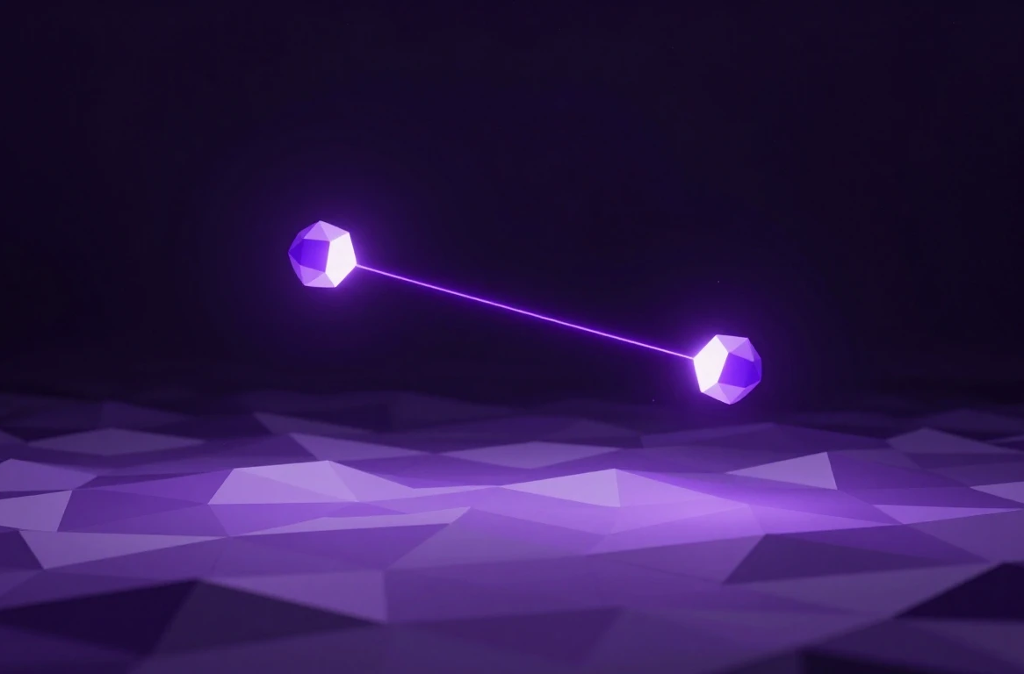
Entanglement:
Spooky Action at a
Distance
Linking qubits together across space
Entanglement
Perfect correlation
The foundation
Entanglement is a unique quantum
link where the state of one qubit
instantly determines the state of
another, no matter how far apart
they are.
Perfect correlation between pairs
The foundation for quantum
communication and complex
calculations

Slide 6
Measurement: The Moment of Truth
Qubit in
superposition
Probability
determines outcome
A qubit exists in a state of
superposition before
measurement.
Probability determines the
outcome of the
measurement.
Act of observing
Collapse into state
The act of observing forces a
choice.
The qubit collapses into a
definite state of 0 or 1.

Slide 7
Quantum Gates Logic Process
Hadamard Gate
Creates a state of
superposition
Quantum Gate
Operation
Bloch Sphere
Rotation
Manipulating qubits
to perform logic
Rotating the qubit's
state on the Bloch
sphere
CNOT Gate
Creates a state of
entanglement

Slide 8
Exponential Power
300 qubits
Add one qubit
Add one bit

Slide 9
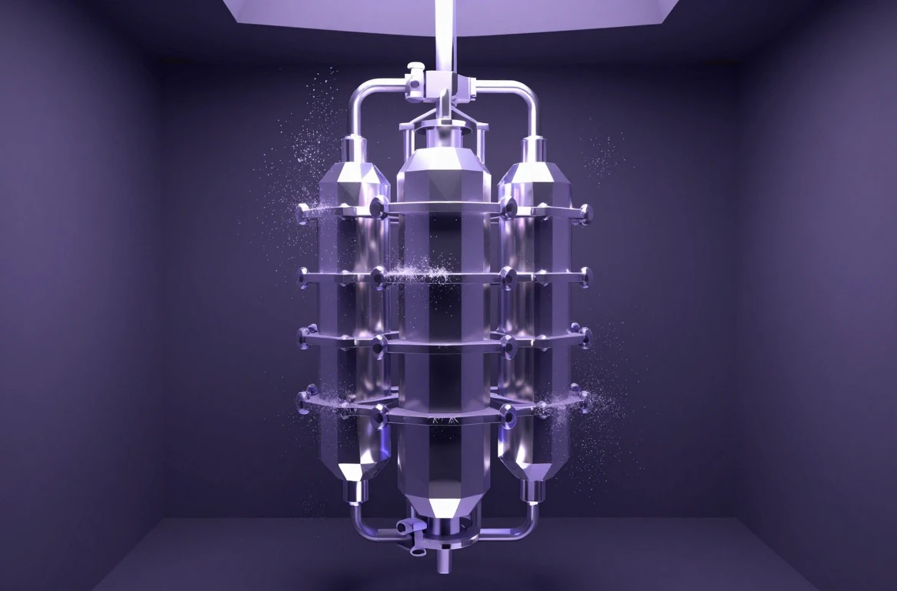
Decoherence: The
Fragility of
Quantum States
Keeping the quantum world quiet
Qubits
Requires extreme cooling
Error correction
Qubits are extremely sensitive. Heat,
vibration, or electromagnetic
interference can cause them to lose
their quantum properties—a
process called decoherence.
Requires extreme cooling (colder
than outer space)
Error correction is a major field of
research

Slide 10
Quantum Computers’ Applications
Pros
Cons
Drug Discovery
Not for Browsing
Cryptography
Complex Optimization

Slide 11

The Future
The Road Ahead
From theory to practical quantum advantage: Future
implications include unbreakable encryption, revolutionary
drug discovery, and solving complex optimization
problems.

Slide 12

Thank You!
Thank you for exploring the world of qubits with
us. We hope this introduction has sparked your
curiosity about the quantum future.
MADE BY
26BCE5277, 26BCE5208, 26BCE5217, 26BCE5211, 26BCE5215,
26BCE5294, 26BCE5288, 26BCE5238

